Slide 1
Department of
ELECTRONICS AND COMMUNICATION ENGINEERING
Security System
GUIDE NAME: Mrs.Anuradha
HOD, ECE dept.
GROUP MEMBERS:
SHREYAS KULKARNI PES1201700450
SANJESH A.J PES1201700436
DILIP.M PES120170

Slide 2
INTRODUCTION
On scanning the wrong tag or on entering the wrong password, it will send us an alert.
On scanning the right tag and on entering the right password, it will send us a confirmation message that the door has opened.
You can halt the system by sending ‘close’ message to Arduino and it will only go back to normal mode when you will send the ‘open’ message to Arduino. During halt time, it won’t scan any tags and it will only look for messages.
You can also open the door by sending message to Arduino.

Slide 3
ABSTRACT:
In the modern day, there is a high demand for advanced security system.It prevents theft of data, information, valuables etc.
But security system should be strong but shouldn’t be complex making it hard for the user
Here, our security system giver double protection using RFID and passwords
It also has an alert system which works with the help of GSM for alerting is
case of a breach
It’s simple yet effective.
2

Slide 4
INTRODUCTION
Electronic security relates to leveraging innovation in defensive holding by anticipatingunapproved access to individuals and property.
The government is a universal and major customer ofsuch security administrations and business sections also utilizes the security systems for their workersfor giving security.
These days, one can witness their usage in range like domestic application and small stores moreover.
In the modern day, there is a high demand for advanced security system. It prevents theft of data, information, valuables etc

Slide 5
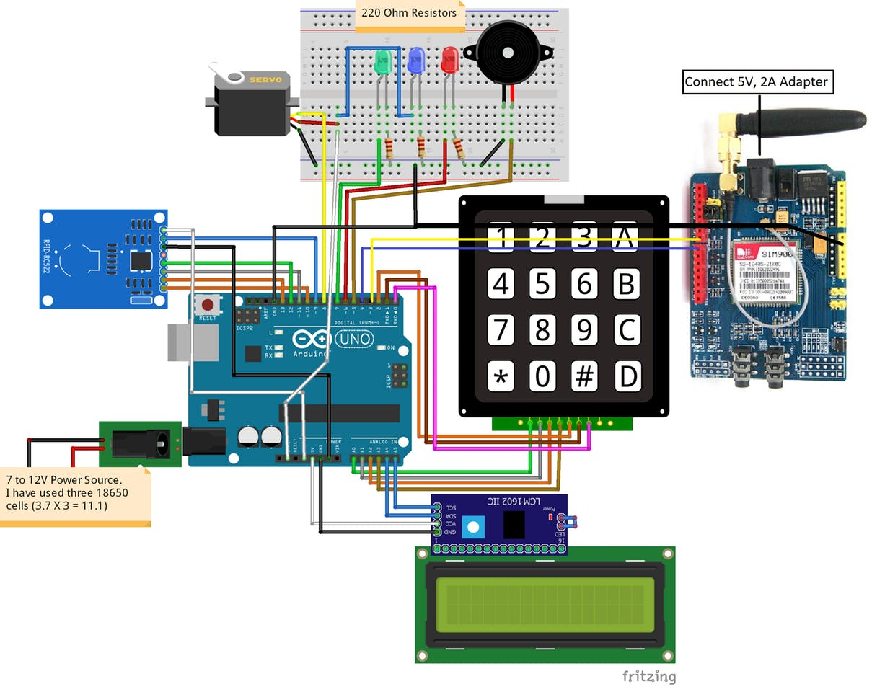
Circuit diagram

Slide 6
METHODOLOGY OF THIS SECURITY SYSTEM:
RFID works on the principle of electromagnetic waves. It has a transmitter and a receiver part. The RFID reader communicates with the Arduino through the SPI protocol and different Arduino boards have different SPI pins.
KEYPAD interfacing is done. Once the RFID tag is matched, the system asks for the password for double layered protection.
The third part comes the GSM module. If there is a wrong access or breach in the system, this module sends a message to the user and alerts about it.

Slide 7
COMPONENTS USED IN OUR PROJECT :
ARDUINO
RFID TRANSMITTER AND RECEIVER
KEYPAD
SERVOMOTOR
16X2 LCD DISPLAY
GSM MODULE
BREAD BOARDS AND JUMPER WIRES
I2C MODLE

Slide 8
4.1 RFID TRANSMITTER:
RFID transmitters transmit data in the form of radio waves.These transmitters do not require external power source.Instead, they use the energy from the radio waves generated.For general use, the RFID has a frequency range of 124 kHz to 135 kHz. For larger applications,range is in MHz.
RFID tags contain at least three parts: an integrated circuit that stores and processes information and that modulates and demodulates radio-frequency (RF) signals; a means of collecting DC power from the incident reader signal; and an antenna for receiving and transmitting the signal. The tag information is stored in a non-volatile memory.
The RFID tag includes either fixed or programmable logic for processing the transmission and sensor data, respectively.
An RFID reader transmits an encoded radio signal to interrogate the tag. The RFID tag receives the message and then responds with its identification and other information. This may be only a unique tag serial number, or may be product-related information such as a stock number, lot or batch number, production date, or other specific information

Slide 9
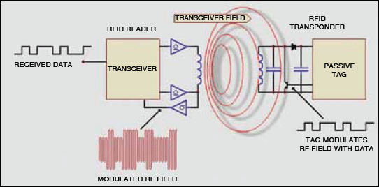

Slide 10
4.2 RFID RECEIVER:
When the RFID tag receives the transmission from the reader/antenna, the energy runs through the internal antenna to the tag’s chip. The energy activates the chip, which modulates the energy with the desired information, and then transmits a signal back toward the antenna/reader.Operating range is between 3m to 10m.
Signaling between the reader and the tag is done in several different incompatible ways, depending on the frequency band used by the tag. Tags operating on LF and HF bands are, in terms of radio wavelength, very close to the reader antenna because they are only a small percentage of a wavelength away. In this near field region, the tag is closely coupled electrically with the transmitter in the reader

Slide 11
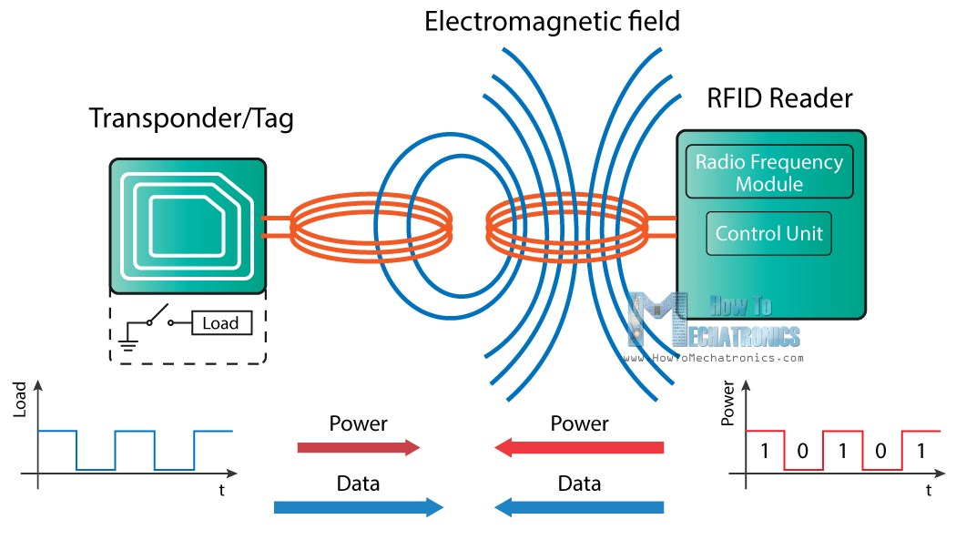

Slide 12
GSM MODULE
GSM stands for Global System for Mobile communication. Today, GSM is used by more than 800 million end users spread across 190 countries which represents around 70 percent of today’s digital wireless market
Sim 900:
Compatible with Arduino and clones
Based on SIM900 module from SIMCOM
Allows you to send SMS, MMS, GPRS and Audio via UART using AT commands.
It has 12 GPIOs, 2 PWMs and built-in ADC of the SIM900 module
Quad Band: 850; 900; 1800 and 1900 MHZ, so it should work in all countries with GSM (2G) networks
Supports RTC (real time clock) – it has a holder for a 3V CR1220 battery at the back
Has microphone and headphone jacks for phone calls and the work on 5V 3A spec.

Slide 13
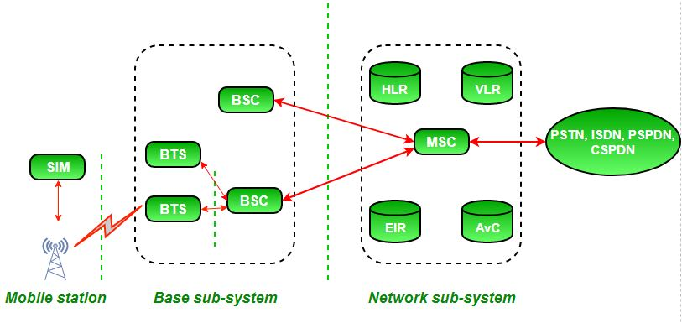
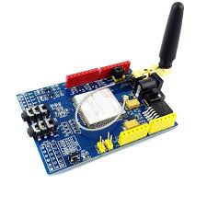

Slide 14
Circuit Diagram and Explanation
The RFID reader communicates with the Arduino through the SPI protocol and different Arduino boards have different SPI pins.
To test if the RFID reader is working properly or not, upload the “dumpinfo” from the examples in the Arduino and see if it is showing the information of the tags on the serial monitor or not. If you are new to RFID, then follow this tutorial | RFID basics and RFID module interfacing with Arduino
The I2C LCD communicates with the Arduino through the I2C protocol. Different Arduino boards have different I2C pins. The I2C pins on Arduino Uno and Arduino Nano are A4, A5.
Next connect the keypad with Arduino. The 4X4 keypad has 8 connections but we don’t require the last column of keypad. We only require numbers for the password. So we won’t use the last pin of keypad which is for fourth column. You can also use 4X3 keypad instead of 4X4 keypad.
For powering the SIM900 module, the recommended power to use is 5V, 2A but I have used the 5V, 1.5A power adapter and it worked fine.
Once you have powered the SIM900 module, the power light will light up and on pressing the power key, the status led should light up and the netlight should start blinking. At this point, make a call from your mobile to the sim you have placed in the SIM900 module. If you are successful in making the call, then your sim is working properly with the SIM900 module.

Slide 15
Next connect the keypad with Arduino. The 4X4 keypad has 8 connections but we don’t require the last column of keypad. We only require numbers for the password. So we won’t use the last pin of keypad which is for fourth column. You can also use 4X3 keypad instead of 4X4 keypad.
For powering the SIM900 module, the recommended power to use is 5V, 2A but I have used the 5V, 1.5A power adapter and it worked fine.
Once you have powered the SIM900 module, the power light will light up and on pressing the power key, the status led should light up and the netlight should start blinking. At this point, make a call from your mobile to the sim you have placed in the SIM900 module. If you are successful in making the call, then your sim is working properly with the SIM900 module.

Slide 16
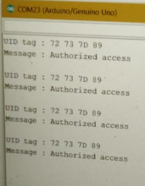
RESULT:
The system asks the user to scan the card.If its a wrong card, the buzzer makes the noise indicating that the card you are trying to access is an unauthorized card.
If its a authorized card, then it displays “Card Accepted”, and asks the user to enter the password on keypad.
If password is wrong, buzzer is turned ON.Else it shows “password accepted” and the servo motor rotates opening the door.
The door is open for a while and then the motor comes back to its initial position.
If there is a wrong access, the GSM technology used sends a message to the users mobile, informing that someone is trying to access their security system
.

Slide 17
FOR WRONG PASSWORDS AND WRONG CARDS:
As shown in the figure 1, the lcd shows “Access Denied” as we have given the wrong card. Figure 2 shows “wrong password” as we tried accessing by entering a wrong password.
figure (3)
In this project, we have inserted a sim card into the GSM module we used. The users mobile number gets stored in that sim. So whenever there is a breach, the sim gets turned ON and send a message to the user. The message is as shown in figure (3).
Controlling with the help of GSM module:
One way of using GSM module is to receive message when there is a breach in security system
But we can also wirelessly control the lock with the help of GSM
On sending open GSM receives the message and opens the door
On sending close the door can be locked
When a wrong rfid card is used then it sends a message
By sending halt message the system will be locked and and can be unlocked by entering the password only.

Slide 18
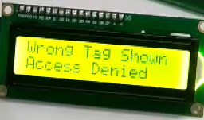
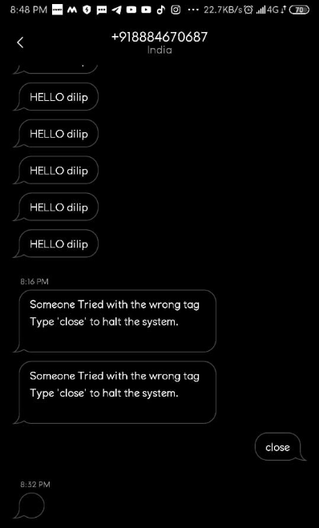
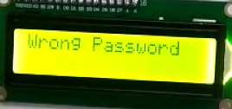
OUTPUT IN LCD AND THE GIVEN MOBILE
figure (2)

Slide 19
FUTURE SCOPE:
Our project give a good idea about the type of security system we are focusing on in this subject.This can be made even better by implementing new technologies like IRIS detection or Face recognition.This will make the system even more advanced and highly protected. Fingerprint scanner is also a good way of security system.Making the system advanced, we can use mobile to unlock the door by sending a message to the GSM module.
Analysts have been predicting an explosion of RFID adoption for the past decade; the market, however, has grown slowly and steadily. A Research and Markets report, though, forecasts global sourcing of RFID tags to have a compound annual growth rate of 22.4% through 2018. Yet another report puts the smart label market at $10 billion by 2020.

Slide 20
CONCLUSION:
We understand the need of electronic security systems.
We also understand how RFID is a cheap and efficient way of providing security to your home or office doors.
This type of system fulfills the need of secure and easily operable security systems.

Slide 21
LITERATURE:
https://www.elprocus.com/rfid-basic-introduction-simple-application/ (RFID WORKING)
https://www.electronicwings.com/arduino/4x4-keypad-interfacing-with-arduino-uno (KEYPAD INTERFACING)
https://www.electronicwings.com/arduino/sim900a-gsm-module-interfacing-with-arduino-uno (ABOUT GSM)

Slide 22
THANK YOU

